Slide 1
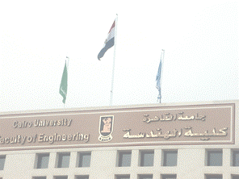
Cellular Wireless
Sections 3.1-3.6 of “Ad Hoc Wireless Networks”

Slide 2
Agenda
Cellular Concepts
  Capacity Enhancements
  Channel Allocation
  Handoff

Slide 3
CELLULAR CONCEPTS

Slide 4
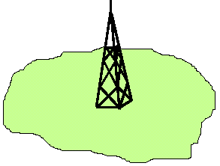
Cellular Concepts
Wide Area Concept
  Single large Area
  High Powered Transmitter
Problem…..
Bad bandwidth utilization !!

Slide 5
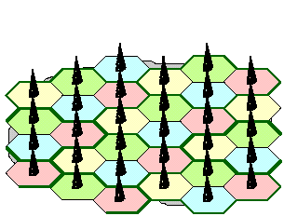
Cellular Concepts
Cellular Concept (many cells, cellular)
  Low-power transmitter
  Small coverage area
  Frequency resuse
  Increase call capacity
Frequency reuse concept:
  Every cell contains completely different frequency band than adjacent cells.
  The same frequency band is reused in non-adjacent cell
  What is the theoretical minimum number of bands in a cellular nework?
    What model to use in order to compute the minimum number of bands?
Better bandwidth Utilizations !!

Slide 6

Cellular system capacity
Consider a spectrum of bandwidth S 25 MHz. Assume that every user requires W 30 KHz bandwidth.
Then a single city-wide cell can support only 25,000/30 = 833 users.
However if the city is split into cells with N 7 cells per cluster, only 1/7th of the spectrum is available in any cell. Hence each cell can support 119 users.
If there are k 20 cells in the city, then the system can support 2,380 users simultaneously.

Slide 7

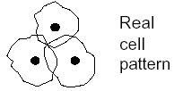
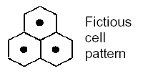
Cell Geometry
Real Cell coverage
Or : Cell footprint
omnidirectional base station antenna
Centre excited cell
Hexagon most closely resembles the nearly circular coverage area of a transmitter

Slide 8
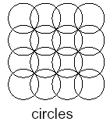
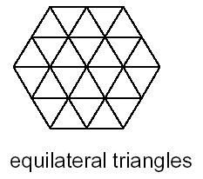
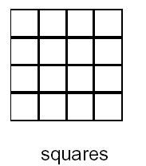
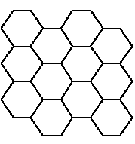
Cell Shape
Ideal cell shape
Non-overlapping geometric cell shapes with equal area
Hexagon
  has the largest area after the circle,
  Arbitrary number of hexagons can be made adjacent
  therefore it is elected for cell planning)
Other shapes (e.g. Octagon) cannot be made adjacent
Hexagon

Slide 9
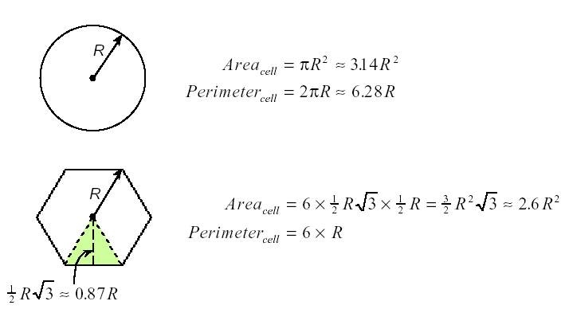
Circle vs Hexagon
R
R
R
R
R
R
R
R
Circle vers. Hexagon geometry

Slide 10
Important Cell Paramemters
Cell: It is an area with a single basestation that uses a single frequency band
Cell Cluster: is the group of adjacent cells using the complete set of the whole available frequencies
Cluster size: is the number of cells in a cell cluster
Co-Channel cells: Cells using the same band
Reuse Distance (co-channel distance): distance between two cells using the same frequency set
  Frequency reuse depends on the fact that EM wave gets attenuated with distance
  Frequency reuse distance is an important design factor
Reuse Factor: Ratio between reuse distance and cell Radius

Slide 11
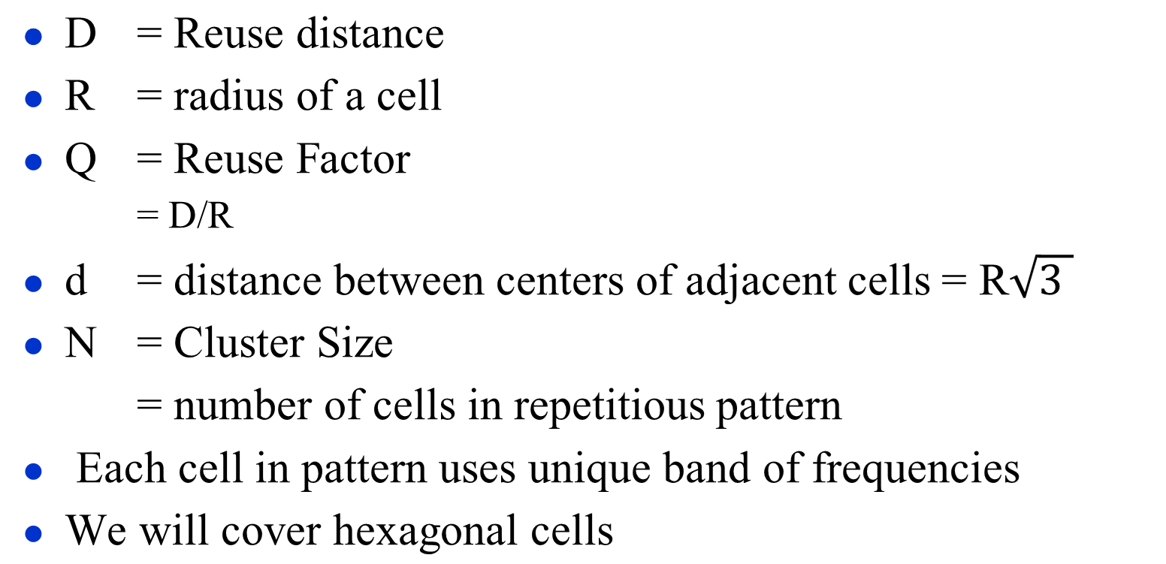
Important Cell Parameters

Slide 12
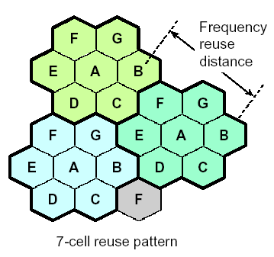
Example
D
R
Cluster size N=7
d

Slide 13
Only Certain Cluster Sizes are Possible
Remember that every cell has to be D distance from the closest co-channel cell
Given
  Hexagonal cells
  We have to satisfy Minimum reuse distance
  Cluster size is governed by the following equation…
N = i² + ij + j²
Where i,j = 0, 1, 2, 3, …
any non negative numbers
Example
  i=1, j=2 → N = 7

Slide 14
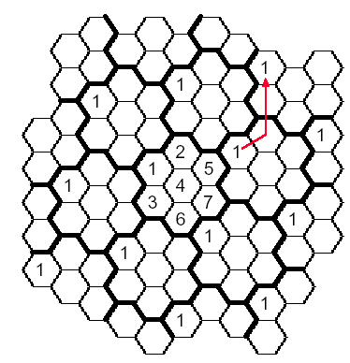
How to find Closest Co-Channel Cell
60°
To find the co-channel cells
i = 1 first move by i=1 cell to any direction
j = 2 then turn 60°and move j=2 cells
N=7-Cell Reuse Pattern

Slide 15
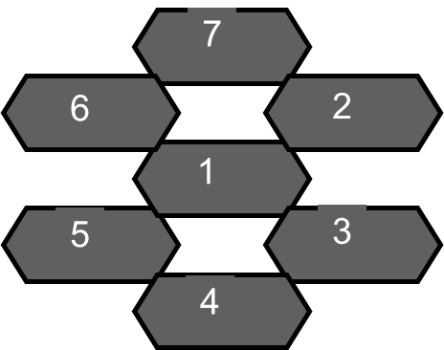
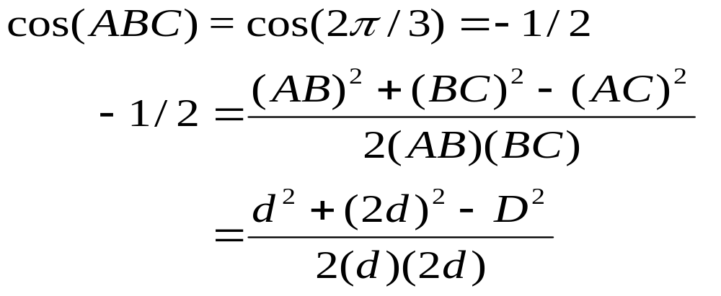
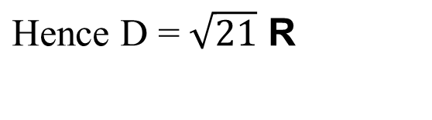
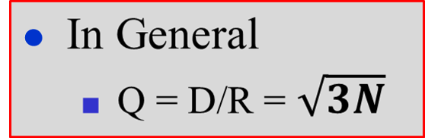
Example: Calculating Reuse Distance
Consider the case of i=1, j=2, N=7
C
D
2d
7
6
2
B
A
1
d
5
3
4

Slide 16
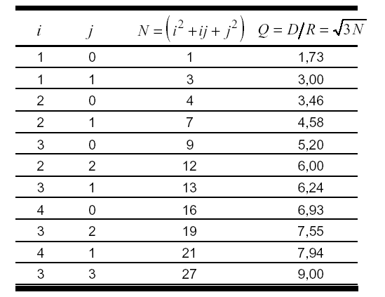
Cell Size N and Reuse Factor Q

Slide 17
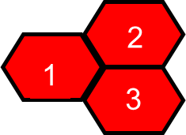

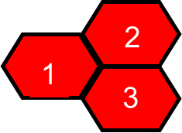
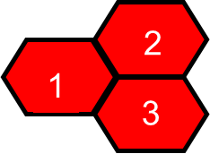
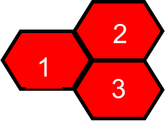

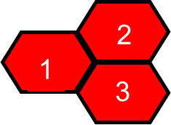
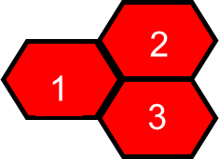

3-Cell Reuse Pattern
i=1, j=1
Cluster Size N :
N = i² + ij + j² = 3
Co-channel reuse ratio Q:
D = 3 R
Q = D/R = √ 3N = 3
=> D= 3 R
Network Geometry
Cluster Geometry

Slide 18
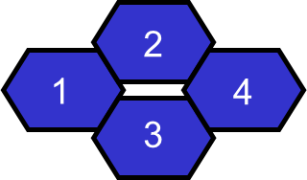
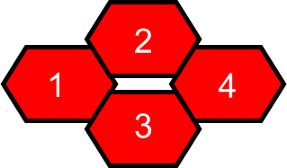
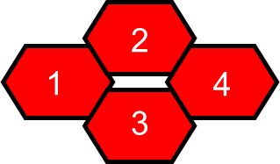
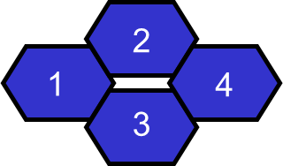

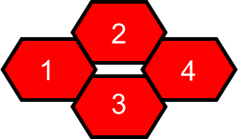
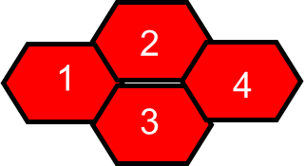
4-Cell Reuse Pattern
i=2, j=0
Cluster Size N :
N = i² + ij + j² = 4
Co-channel reuse ratio Q:
Q = D/R = √ 3N = 3.46
D=3.46 R
Network Geometry
Cluster Geometry

Slide 19
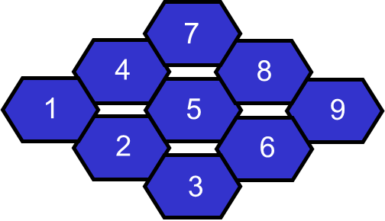
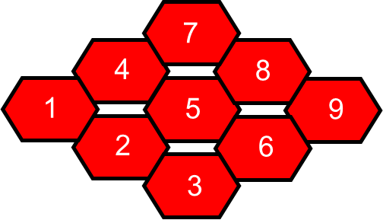
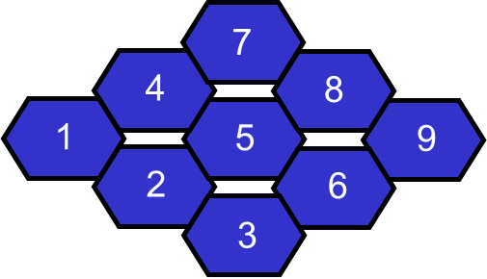
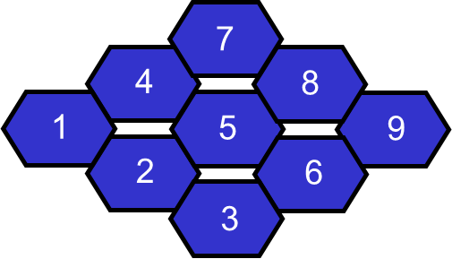
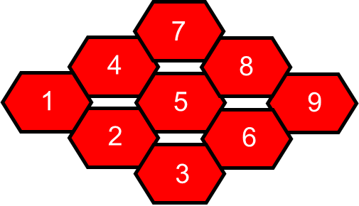
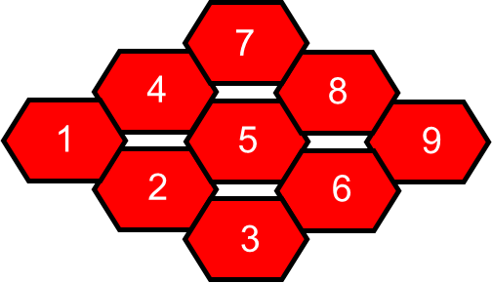
9-Cell Reuse Pattern
i=3, j=0
Cluster Size N :
N = i² + ij + j² = 9
7
Co-channel reuse ratio Q:
4
Q = D/R = √ 3N = 5.20
5
1
5
2
3
7
4
5
1
5
7
2
4
8
3
5
1
5
9
Cluster Geometry
Network Geometry
2
6

Slide 20
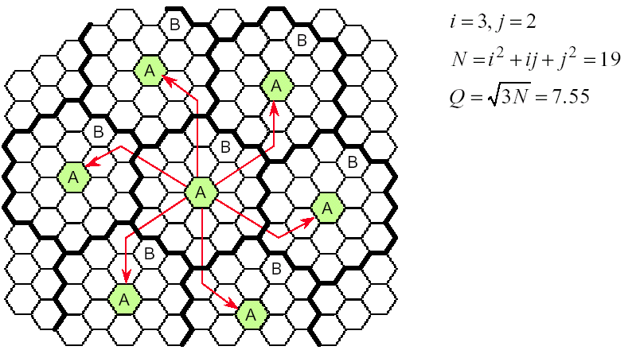
19-Cell Reuse Pattern

Slide 21
Cell Interference
Co-Channel Interference
  Comes from cells using the same frequency in other clusters
  Choose good reuse distance
Adjacent Cell interference
  Use of close frequency ranges in the same cluster
2
2
2
1
1
1
3
3
3
2
2
2
2
1
1
1
1
3
3
3
3
D
2
2
2
2
1
1
1
1
3
3
3
3
first tier
2
2
2
2
1
1
1
1
3
3
3
3
2
2
2
1
1
1
second tier
3
3
3

Slide 22
CELLULAR CONCEPTS
INTERFERENCE

Slide 23
Interference
  Co-Channel Interference (CCI)
  Adjacent Channel Interference (ACI)
  Other services: like a competitor cellular service in the same area

Slide 24
Co-Channel Interference
Co-Channel Interference and System Capacity
The cells that use the same set of frequencies are called co-channel cells.
The interference between signals from these cells is called Co-Channel Interference (CCI).
Cannot be controlled by increasing RF power. Rather, this will increase CCI.
Depends on minimum distance between co-channels.

Slide 25
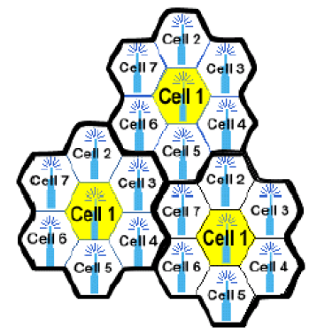
Co-Channel Interference
The yellow cells use the same set of frequency channels, and hence, interfere with each other
In the cellular system there are 6 first-layer co-channels
In constant cell size and RF power, CCI is a function of Distance between the co-channel cells(D), and the size of each cell (R).
Increasing ratio D/R, CCI decreases.

Slide 26
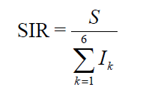

Co-Channel Interference
Signal-to-interference ratio
S is the power of the signal of interest and is the power of kth interference.
The signal strength at distance d from a source is
That is, received signal power is inversely related to nth power of the distance.
n = path loss exponent

Slide 27
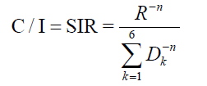


Co-Channel Interference
P2/P1 = 10^(A/10)
Then we can express the SIR in terms of distance
where the denominator represents the users in neighboring clusters using the same channel
Let be the distance between cell centers. Then
Note how C/I improves with the frequency reuse N.

Slide 28
Conversion Power ratio to db
A = 10*log10(P2/P1)
P2/P1 = 10^(A/10) , A in db
Analog systems: U.S. AMPS required C/I ~= 18dB For n = 4, the reuse factor for AMPS is N ≥ 6.49, so N = 7.
Now, let us consider the worst case for a cluster size of N= 7. The mobile is at the edge of the cell. Express C/I as a function of actual distances.

Slide 29
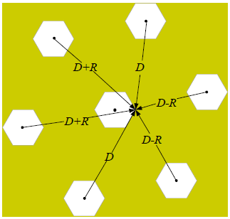
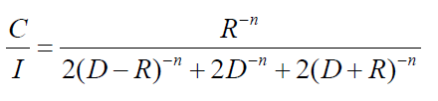
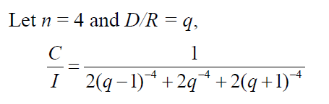
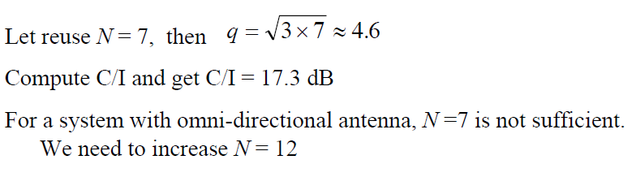
Worst Case Design
Worst case carrier-to-interference ratio

Slide 30
Worst Case Design
Increasing N from 7 to 12, brings C/I above the 18dB level. However, the system capacity is decreased.
Reduction of capacity by 7/12 for taking care of the worst case situation when CIR ~= 17.4 dB is not justified because this situation will occur very rarely.
Conclusion: Co-Channel Interference controls the link performance which then decides Frequency Reuse Plan, and System Capacity.

Slide 31
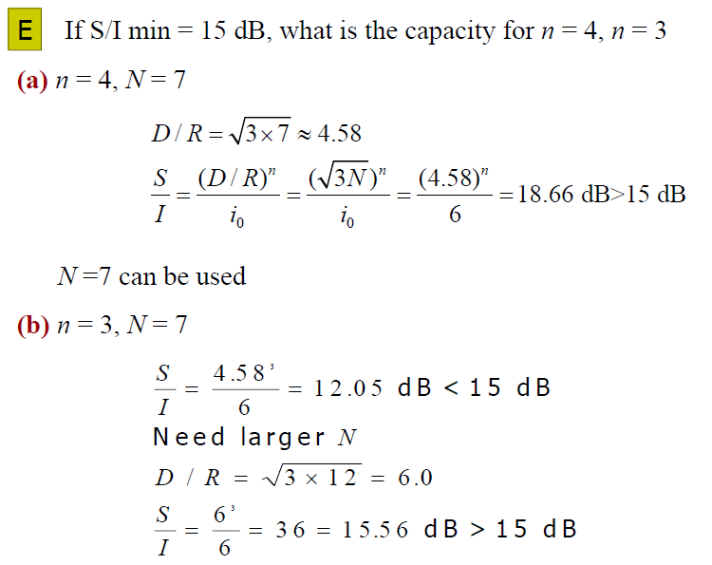
Co-Channel Interference Example

Slide 32
Adjacent Channel Interference
Interference from channels that are adjacent in frequency,
The primary reason for that is Imperfect Receive Filters which cause the adjacent channel energy to leak into your spectrum.
Problem is severer if the user of adjacent channel is in close proximity. → Near-Far Effect
Near-Far Effect: The other transmitter(who may or may not be of the same type) captures the receiver of the subscriber.
Also, when a Mobile Station close to the Base Station transmits on a channel close to the one being used by a weaker mobile: The BS faces difficulty in discriminating the desired mobile user from the “bleed over” of the adjacent channel mobile.

Slide 33
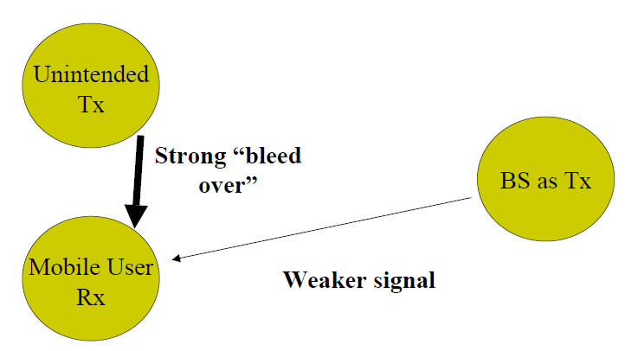
Near-Far Effect: Case 1
The Mobile receiver is captured by the unintended, unknown transmitter, instead of the desired base station

Slide 34
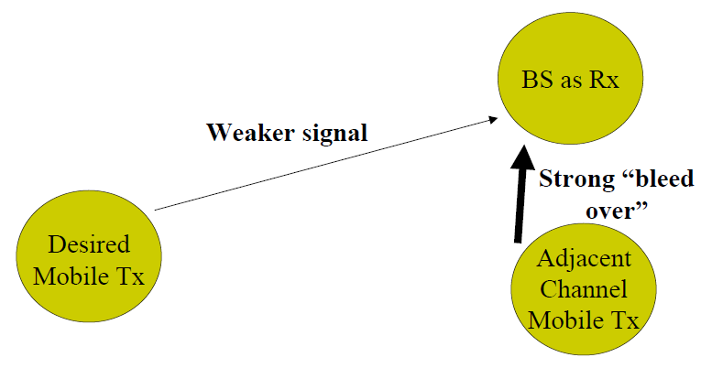
Near-Far Effect: Case 2
The Base Station faces difficulty in recognizing the actual mobile user, when the adjacent channel bleed over is too high.

Slide 35
CAPACITY ENHANCEMENT

Slide 36
Capacity Enhancement
Main reasons for reduction of capacity
  Off center antenna
  Strict clustering limiting frequency reuse
  Inhomogeneous propagation
Closest BS may not always be the best due to (why?):
  Fading and shadowing
  Inhomogeneous attenuation
  Interference from other non-cellular sources

Slide 37
Capacity Enhancement
Ideas
Cell splitting
  Non-uniform distribution of topography and traffic
  Smaller cells in high use areas
    More frequent handoff, More base stations
Add new channels
  Not all channels used to start with
Frequency borrowing
  Taken from adjacent cells by congested cells
  Or assign frequencies dynamically
Power control

Slide 38
Capacity Enhancement
1. Cell Splitting
Hot spots: regions with high demand
Introduce multiple layers of cells
Have another layer of smaller cells to support users of low mobility
  Micro-cells: Spans less than 1 Km
  Pico-Cells: Spans few meters
Use existing macro-cells to support high mobility users
  Spans tens of kilometers
Micro/Pico Cells
  Move antennas to tops of small buildings, even lamp posts
  Form micro cells, reduced power
  Good for city streets, along roads and inside large buildings

Slide 39
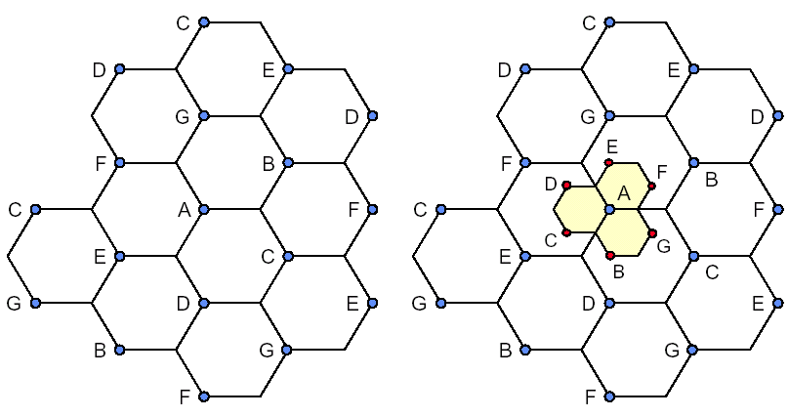
Capacity Enhancement
Cell Splitting

Slide 40
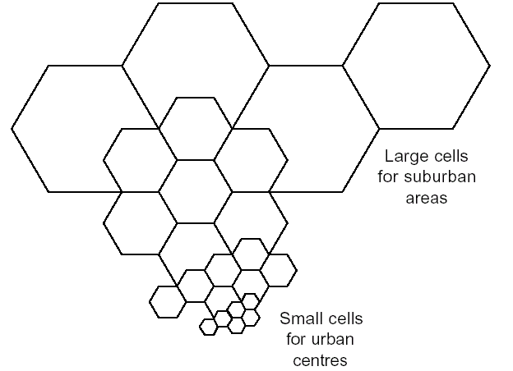
Capacity Enhancement
Cell Splitting Example
Original Cells
Typical parameters:
Macro-cell: Radius=1-20km, P_{t} =1-10 watt
Micro-cell: Radius=0.1-1 km, P_{t} = 0.1-1 watt
Pico-cell: Radius=10-100m, P_{t} = 1-100 m watt
Nano-cell: ......
Micro-Cells
Pico-Cells

Slide 41
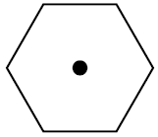

Capacity Enhancement
2. Sectorizing
Apply Space Division Multiple Access (SDMA) concept
Omni direction
6- sector Sectorized
Usually split into three 120-degrees or six 60-degrees cells
Directional antenna
Tilt antenna to reduce co-channel interference

Slide 42

Capacity Enhancement
Sectorizing Configurations

Slide 43
Capacity Enhancement
3. Power Control
BS issues power control orders
  Power levels transmitted by every subscriber unit are under constant control by the Base Station.
  BS receives almost equal power from all MTs, irrespective of distance
MT closer to the BS need to use less power
  Mobile Station should transmit minimum power to maintain quality link on reverse channel.
  Saves MT power
  Reduce interference → increase reusability

Slide 44
Capacity versus interference for same size cell
Decrease N for More Capacity: If Cluster Size, N is decreased while cell size remains fixed, more clusters are required to cover the area (M increases). Therefore, Capacity increases.
Increase N for Less Interference: On the other hand, if N is increased (large cluster size) means that co-channels are now farther than before, and hence we will have less interference.
Value of N is a function of how much interference a mobile or a base station can tolerate.

Slide 45
CHANNEL ALLOCATION

Slide 46
Channel Allocation Algorithms
Fixed Channel allocation schemes
Dynamic channel allocation schemes
Hybrid channel allocation schemes
Typically 5% of the channels are used for control, mostly One control channel/cell
Rest channels for payload (voice, data, ...)
Channel allocation schemes must not violate channel reuse distance

Slide 47
Channel Allocation Algorithms
Fixed Channel Allocation
Channel allocation per cell is done apriori
Channel borrowing may be allowed
  Help alleviate increase in demand
  May prevent other cells from borrowing due to channel reuse restriction → channel locking
Drawback
  Assume constant and/or predictable load distribution over cells
  In reality load is unpredictable

Slide 48
Channel Allocation Algorithms
Dynamic Channel Allocation
No apriori channel allocation
May require central arbitrator → bottleneck !!
Distributed algorithm
  BS looks at local information to predict possible interference
Advantages
  Very flexible
  Efficient use of bandwidth
Drawback
  Complex, lots of computation
  distributed schemes may not be accurate
  Central arbitrator is a bottleneck

Slide 49
Channel Allocation Algorithms
Hybrid Channel Allocation
Each cell is allocated two sets of channels
  Local channels
  Borrowable channels
Cells can only lend channels from the borrowable set
Advantages
  Good flexibility
  Intermediate complexity and computation

Slide 50
HANDOFF

Slide 51




Example of Mobile Call
1. Monitor for strongest signal
2. Request for connection
3. Paging
4. Call accepted
5. Ongoing call
6. Handoff (change to other cell)
MTSO: Mobile Telecommunication Switching Office
Handoff considerations !

Slide 52
Handoff
When a mobile moves into a different cell while a conversation is in progress, MSC transfers the call to a new channel belonging to the new base station. (Hard handoff) – Break before Make
In modern wireless systems, there may be no change in the actual channel; only the base station changes (Soft Hand off).
Mobile Switching Center needs to:
  Identify the new base station
  Allocate new Voice and Control channels associated with the new base station.

Slide 53
Handoff Issues
Handoff (A.K.A. handover) = Move from one BS to adjacent BS
Issues:
  Which BS is optimal: The nearest BS may not be the optimal
  Avoid ping-pong oscillations
  Avoid data loss
    Short delay is not an issue in voice
    In data few bits loss may be an issue
  Subscriber or BS initiated?
    Subscriber requests handoff if signal strength falls below a certain threshold
    BS initiated: BS forces handoff if signal weakens
    Mobile assisted:
      Considers MT signal strength
      Final decision is taken by BS

Slide 54
Handoff
Quality Metrics
Handoff delay
  Signaling required for handoff introduces delay
  May cause carrier to interference (C/I) to drop below continuation threshold → call dropped !!
Duration of interruption
  Hard handoff: channel pair from BS₁ is canceled and new channel pair from BS₂ is used
  Undetectable by humans but bad for data → need to be minimized
Probability of successful handoff
  Success rate: probability of call continuation across handoff
  Affected by:
    availability of channel pair
    Ability to handoff before C/I falls below drop threshold
Probability of unnecessary handoff
  Increase signaling overhead → unnecessary delay and interruptions

Slide 55
Improved Handoff Strategies
Higher priority to handoff than new connections
Soft Handoffs: Connected to both BS for a short time
  In the overlap region, MT belongs to both BS → need to tune to both frequencies
Predictive handoffs:
  Use speed and direction to predict next BS
  Help predicting channel requirement and handoff in adjacent cells
Hysteresis effect to decide whether new BS is better than old
Adaptive handoffs (mixed cell architecture):
  Shift between pico-, micro-, macro-cellular depending on the mobility pattern changes during the call

Slide 56


Improved Handoff Strategies
Relative Signal Strength: Hysteresis
Avoid ping-pong
Use handoff threshold margin
Use dwell time:
  Minimum time MT must be in the cell before requesting handoff
  Depends on MT speed and mobility
  Too long → prevent handoff → call dropped !!
  Too short → ping-pong effect

Slide 57

Improved Handoff Strategies
Hysteresis
A
B
Signal strength received from the new BS > signal strength of the current BS signal by H
Handover
thresholds
Crossover
signal strength
Handover
For threshold Th₂
Handover
With hysteresis H
Handover
For threshold Th₃

Slide 58

Improved Handoff Strategies
Adaptive Handoff (Umbrella Cell Approach)
The Umbrella Cell Approach

Slide 59


Improved Handoff Strategies
Adaptive Handoff (Umbrella Cell Approach)
Large Umbrella cell
For high speed traffic
Small microcells
for low speed traffic
Users may be shifted from different levels of cells
Based on user mobility characteristics

Slide 60
Umbrella cell approach
Minimizes the number of hand offs for high speed users
Provides additional micro-cell users for pedestrians.
A High speed user converting into a low speed user may be switched to smaller micro-cell by the Base Station, without MSC intervention.

